Slide 1

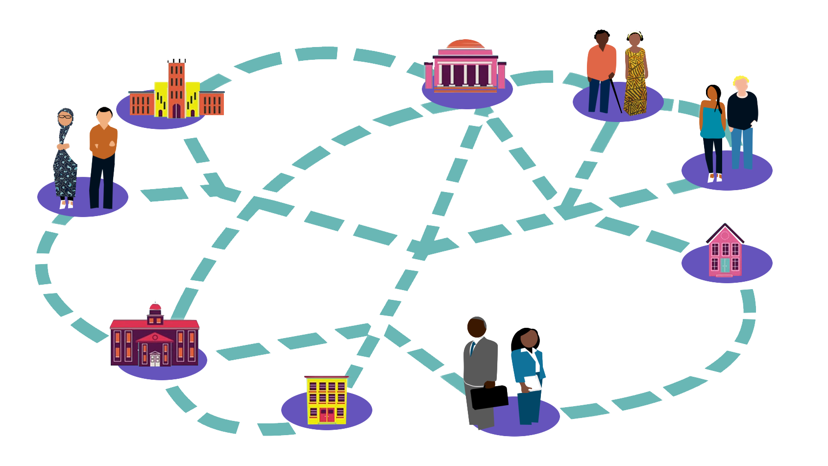
ICEH Open Education Webinar series What is Open Education? Why is ICEH using Open Education as part of our education strategy? Jan 31st 2017 1-1.45pm UCT

Slide 2

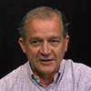
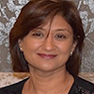
Welcome!
Ms Sally Parsley (Host) Technical lead, Open Education Programme, International Centre for Eye Health
Overview
Welcome & introductions
Presentation 1: Prof. Foster
Presentation 2: Dr Patel
Q & A
Professor Allen Foster Co-Director, International Centre for Eye Health
Dr Daksha Patel E-learning Director, International Centre for Eye Health

Slide 3
Global Visual Impairment and
the Human Resource Challenge
Professor Allen Foster
2017

Slide 4
Data on Global Blindness and Visual Impairment
Year | Author | Blind | Moderate / Severe VI
 |  | <3/60 - NPL | <6/18-3/60
1990 | Thylefors | 38m | 110m + RE
2010 | Pascolini | 38.9m | 246m
1990 | Stevens | 31.8m | 172m
2010 | Stevens | 32.4m | 191m

Slide 5
Global Statistics of Visual Loss: 2010
32 m
VISUAL IMPAIRMENT 223m
3/60
191 million
Low Vision
6/18
7300 million

Slide 6
Blind people/million population by region:
1990 and 2010

Slide 7
Blindness by Cause, 2010
Stevens et al
Cause | No | %
Cataract | 10.8 | 33
Uncorrected Ref. Err. | 6.8 | 21
Trachoma | 0.5 | 2
Glaucoma | 2.1 | 7
(Children) | 1.3 | 4
Diabetic Retinopathy | 0.8 | 3
Macula Degeneration | 2.1 | 7
All Other causes | 8.0 | 23
Total | 32.4 | 100

Slide 8
Ophthalmologists
Between 150,000 – 200,000 ophthalmologists
in the world (7.3 billion).
20 – 30 / million population

Slide 9
Eye Doctors per Million population
0
20
40
60
80
100
50-100
AMERICAS
W. EUROPE
INDIA
CHINA
AFRICA
20-60
10-20
10-20
1-5

Slide 10
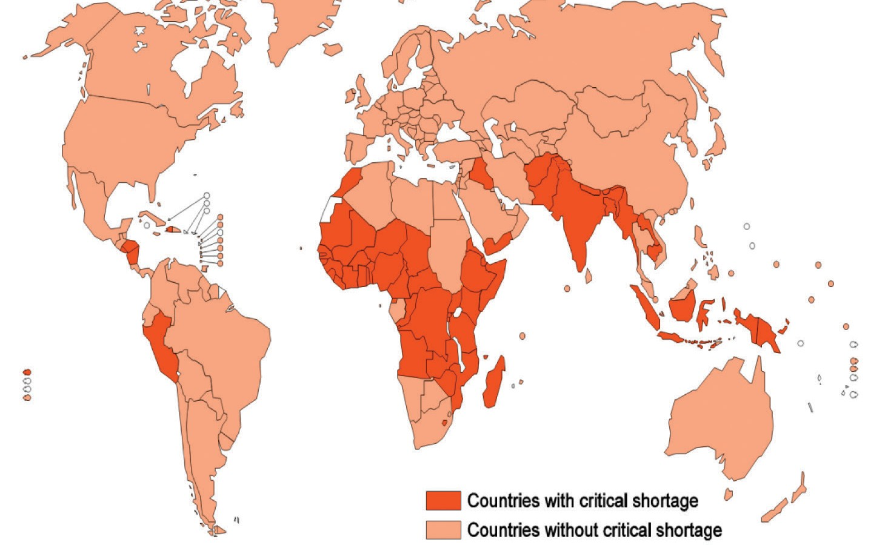
Distribution of Ophthalmologists

Slide 11
Africa
NEED
10% of the Global Population
Approximately 5 million blind
RESOURCES
1% of Global Health Resources
1 % of Global Ophthalmologists

Slide 12
Ophthalmologists in Africa
Linguistic Areas | Population (millions) | Ophthal- mologists | Cataract Surgeons | Per Million
Anglophone | 521 | 1,276 | 291 | 3.0
Francophone | 259 | 501 | 147 | 2.5
Lusophone | 98 | 37 | n/a | 0.4
Totals | 827 | 1,814 | 438 | 2.7

Slide 13
Gap in eye health staff in Africa
Cadre | Targets | Needs by 2020 | Available | Gap
Ophthalmologist | 1/250,000 | 4,000 | 1,814 | 2,186
Optometrist | 1/250,000 | 4,000 | 6,895
Allied Eye Health Professional | 1/100,000 | 10,000 | 5,003 | 4,997

Slide 14
Ophthalmic Training Centres (TC) in Africa
Cadre | Anglophone | Francophone | Lusophone | Total
Population | 522m | 259m | 47m | 828m
TC for Ophth’logists | 39 | 9 | 2 | 50 (1/16 mill.pop)
TC for Optometrists | 20 | 3 | 1 | 24
TC for Allied Eye Health Professionals | 22 | 11 | 3 | 36

Slide 15
Eye Care Team for 1 mill. pop: Community & District
Cadre | Activity | Per week | Per Year | Number
Ophthalmologist/Cataract surgeon | Cataract surgery | 10-20 | 500-1000 | Min 4 Max 20 (CSR 2000-4000)
Eye nurse / assistant | Out-patients / theatre / outreach | 2 -3 per ophthalmologist |  | Min 10
Optometrist | Refract and technical assistant | 100 / week | 5,000 per year | Min 10 5% population refracted / yr
Community Health worker | Screens VA, Treats red eye, Treats presbyopia | 20 families per week | 1000 families /yr 5,000 people / yr | About 200

Slide 16

Global Action Plan

Slide 17
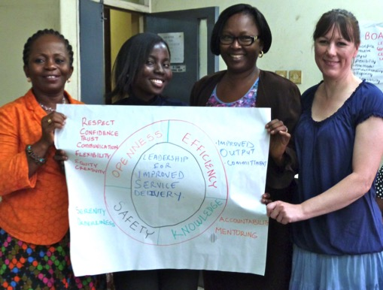
ICEH Education Activities
MSc Public Health Eye Care 15- 20 places / year
Community Eye Health Journal
4 issues per year
Short courses / workshops Variable
Links Programme
28 ongoing UK-Africa Partners
Open Education

Slide 18
ICEH Open Education Webinar series

Slide 19
Open Education for eye care
Dr Daksha Patel
2017

Slide 20
Key discussion points
What is Open Education?
Is it relevant and applicable for eye care education?
What is available from ICEH at LSHTM?

Slide 21
Open Education: What is it?
OPEN
EDUCATION
No barriers or obstacles
Accessible
Legally unrestricted,
Not in silos/collaborative
Free?
Not to be confused with a place e.g school
Origin Greek – “Educere” – to bring out or develop potential
Deliberate –hopeful - informed and respectful –invites truth and possibility
Grounded in co-operation
Deliberate act to develop understanding , judgement and enable action

Slide 22
Open education
Open Education - philosophy to produce, share, and build on knowledge.
Proponents of OE believe everyone in the world should have access to high-quality educational experiences and resources.
Begin to address barriers e.g.
Cost of education,
outdated or obsolete teaching materials,
legal mechanisms that prevent collaboration among scholars and educators.

Slide 23

Brief history: from RLO to OER to MOOC
REUSABLE LEARNING OBJECTS (RLO)
Specific content not context
Sharing digital and non digital
Pedagogy unsupported ? Quality and sustainability
2009-11 MOOC , COURSERA
Large numbers,
structured + assessment
Nelsons review
Educators sharing expertise = quality improvement
Efficiency saving
2002–9 Innovations
Launch of Openlearn (OU)
China ( CORE)
Khan Academy
1982
2000
20O2
2009
2011- 2017
1989 Invention of WWW
2002 – CREATIVE COMMONS LICENSES
OER – OPEN EDUCATIONAL RESOURCE
Hewlet foundation funded MIT
Launch of Open courseware
2007 – CAPE TOWN OPEN EDUCATION DECLARATION

Slide 24
Open Educational Resources
O
Open = use, reuse, share, adapt no / limited restrictions
Online in public domain
E
Content and curriculum driven ,educator supported
R
Unlimited participants
Multi mode teaching methods
Personalised – Formative assessment
Adaptive – as a whole , in sections
Learning through activities
Student centered – self regulated – self paced
Reuse, retain, revise, remix , redistribute
Contribute to other projects

Slide 25
OERs, MOOCs and OEP
Opportunities for eye care :
Use
Reuse
Share
Adapt
Flexible learning
Networking people and knowledge
Build communities of practice
Challenges
Connectivity and digital literacy remains a challenge
Lack of time
Institutional policies
Open data
OER
Open Educational resources
MOOC
Massive
Open
Online
Courses
Videos/ podcasts/blogs
Digital / non digital Journals
Open course ware

Slide 26
Challenges for eye health education
Training Programme level*
Individual practitioner level
Small / aging training faculty
High disease burden - Time tensions
Limited budgets for expansion
Limited infrastructure
Variable training resources – educators need to keep up.
Student learning style influenced by social networks and internet.
Curriculli not aligned with National Eye health strategy
Access to learning is limited - especially mid level providers
Cost of training
Limited time for learning - workload
Limited availability for professional development.
Selection criteria
* In LMIC settings of high need

Slide 27
Training barriers identified for public health in eye care
Few post graduate training opportunities – e.g MSc has ~20 places per year
Training programmes are expensive
Scholarships are few
Rigid selection/ admissions criteria
Clinician is away from family and clinics
Knowledge application and relevance for a local level.
Learners are changing – can educators keep up?
Can we address these issues?

Slide 28
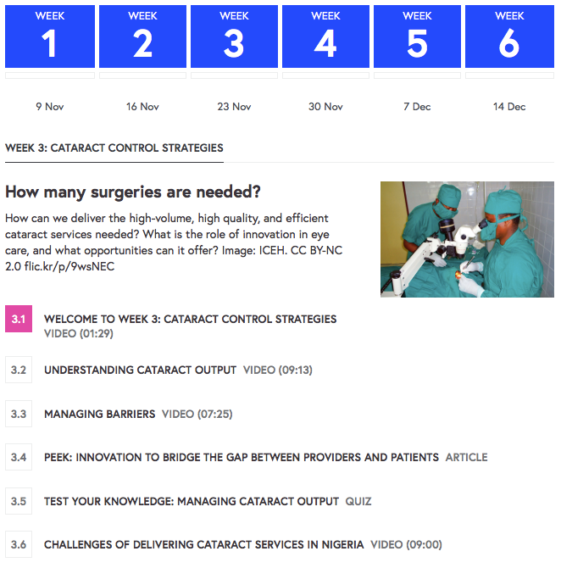
What have we developed so far
Global blindness: Planning and managing eye care services MOOC & Open Study course 3rd run starts 20th Feb on FutureLearn https://www.futurelearn.com/courses/global-blindness/3
Ophthalmic epidemiology – Part 1. Basic principles – Part 2. Application to eye disease http://open.lshtm.ac.uk/course/index.php?categoryid=2
Eliminating Trachoma – 2nd Run on FutureLearn 17th April 2017

Slide 29
Pathways for Open Education
in local settings
Open Education
Individual
Full course
Pick and choose content
Educators
Add to
curriculum
Add to CV / CPD / Accreditation
Add to
teaching session
Flipped learning
ADAPT
Take components and redesign
Institution / Professional body
ACCREDITATION
Flexibility / quality / faculty support

Slide 30
Future courses
Diabetic Eye Disease: patient to health system - end of 2017
Retinopathy of Prematurity –2018
Research Methods in Ophthalmology -2018
Glaucoma – planned for 2019

Slide 31
Q&A
Ms Sally Parsley (Host) Technical lead, Open Education Programme, International Centre for Eye Health
Professor Allen Foster Co-Director, International Centre for Eye Health
Dr Daksha Patel E-learning Director, International Centre for Eye Health

Slide 32





Thanks to our funders
Join us next time!
Will Open Education work for educators and learners? February 22nd 2017(1-1.45pm UCT)
Dr Daksha Patel, ICEH Dr Rob Farrow, Open University
Find out more: http://iceh.lshtm.ac.uk/oer/

Slide 33

© 2017 International Centre for Eye Health, London School of Hygiene & Tropical Medicine. Licensed under the Creative Commons Attribution Non-Commercial Share-Alike 4.0 International License https://creativecommons.org/licenses/by-nc-sa/4.0
We encourage the re-use, adaptation and sharing of this material for teaching and learning. Find more eye care Open Educational Resources at http://iceh.lshtm.ac.uk

