Slide 1
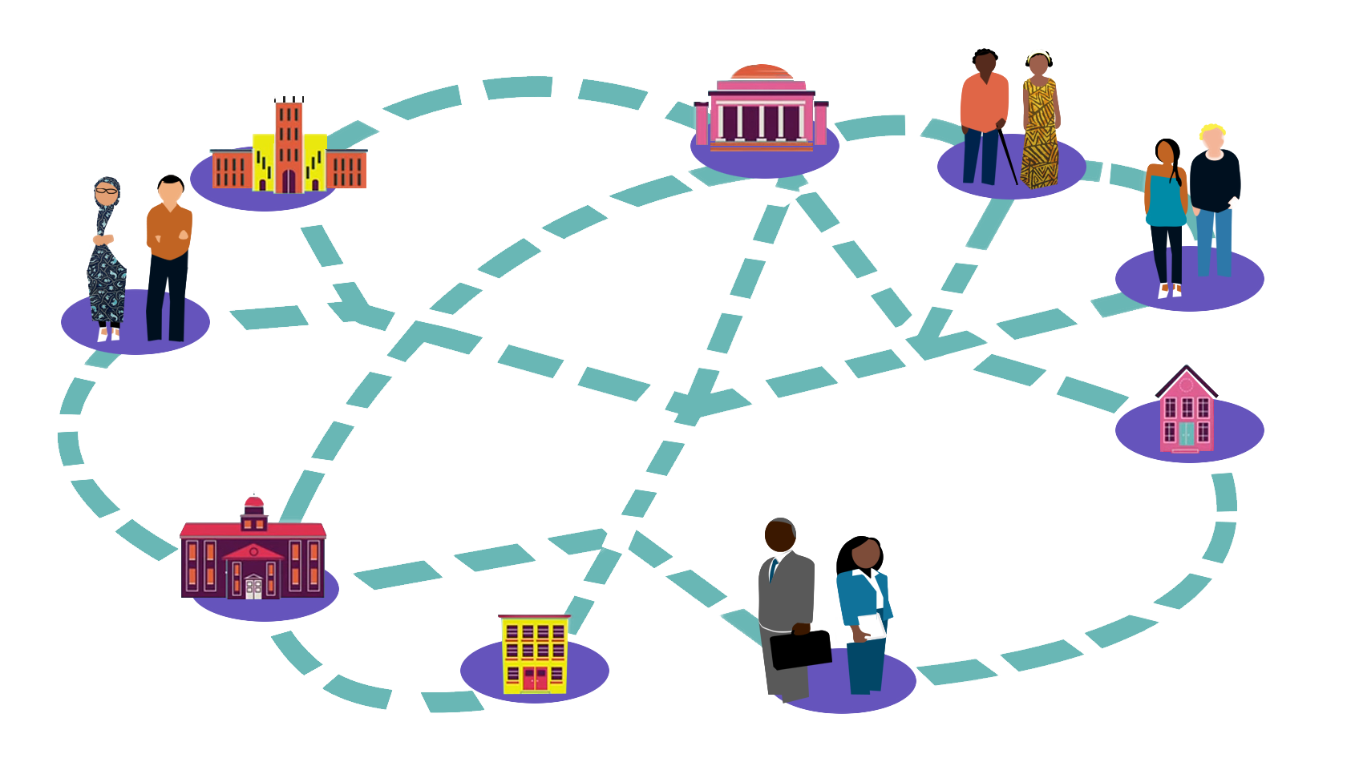
ICEH Open Education webinar series Open Education - does it work for educators and learners? Feb 22nd 2017 1-1.45pm UCT
ICEH Open Education webinar series: http://iceh.lshtm.ac.uk/oer/webinars/
Improving health worldwide
www.lshtm.ac.uk

Slide 2
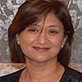
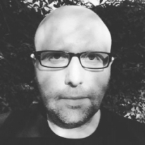
Welcome!
Overview
Welcome & introductions
Presentation 1: Dr Patel
Presentation 2: Dr Rob Farrow
Q & A
Ms Sally Parsley (Host) Technical lead, Open Education Programme, International Centre for Eye Health, LSHTM
Dr Daksha Patel E-learning Director, International Centre for Eye Health, LSHTM
Dr Rob Farrow Research Fellow, Learning and Teaching Innovation, Institute of Educational Technology, Open University

Slide 3
Dr Daksha Patel
Overview
What is Open Education?
Explore the relevance of Open Education for teaching and learning in eye care
What have we learnt from our experience?
Can we use Open Education to support curriculum development, support faculty and assure quality?

Slide 4
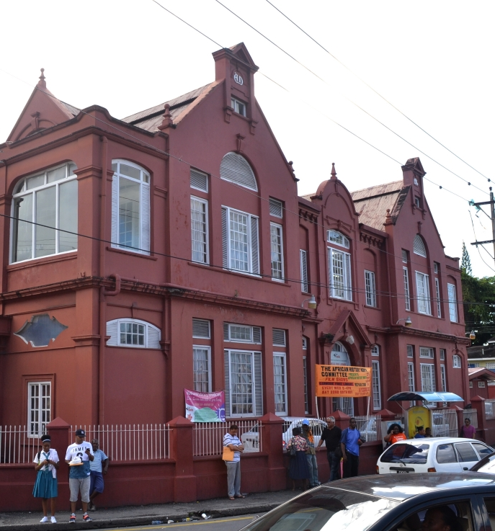
What is Open Education?
Simply put, Open Education is about reducing barriers to participation in education and learning
Open Education has a long history!
Open Education is also about cultural issues, e.g. ‘life-long’ learning, attitudes to sharing, empowerment
Increasing recognition that, globally, education is being transformed. Open Education can play a significant role.
Text adapted from the Open Education Handbook © Wikimedia Foundation Creative Commons Attribution-ShareAlike License
Open Education Resources are digital materials (e.g. video, quiz, book, photo) which anyone can use, reuse, and redistribute for free and without asking for permission.
San Fernando Andrew Carnegie library, Trinidad & Tobago
© JuliaC2006 CC BY 2.0

Slide 5
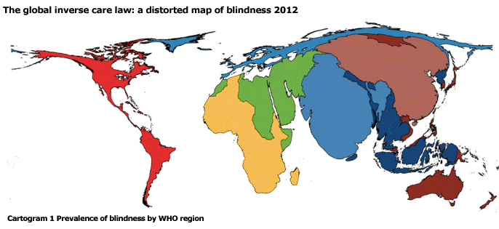
Distribution of blindness
Size of WHO region relative to burden of blindness
246 million visual loss + 39 million blind
80% from avoidable causes
© BMJ Publishing Group Limited.

Slide 6
Public health spending
© Copyright Worldmapper.org / Sasi Group (University of Sheffield) and Mark Newman (University of Michigan) Creative Commons Licence

Slide 7
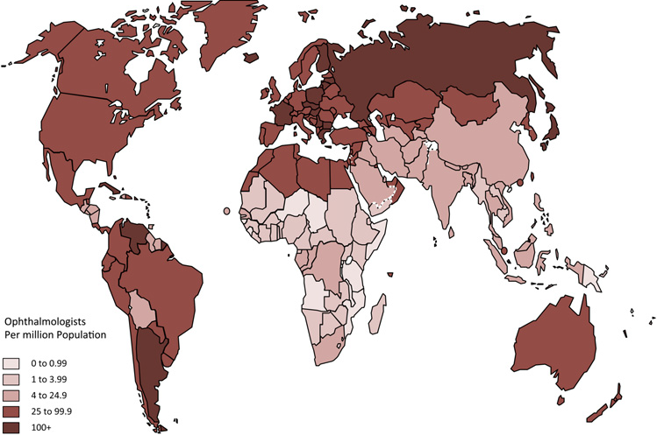
Ophthalmologist / million population Resnikoff S, Felch W, Gauthier T-M, et al. Br J Ophthalmol (2012). doi:10.1136/bjophthalmol-2011-301378
© BMJ Publishing Group Limited.

Slide 8
Mapping study- evidence Trends and implications for achieving VISION2020 human resources for eye health targets in16 countries of sub-Saharan Africa by the year 2020. Palmer et al. Human Resources for Health 2014, 12:45
Challenges
Wider range of practitioners & teams
Many in remote settings –allied eye health workers
Clinicians double up as trainers
Resources for trainers are limited
Continuing education vs clinical activities
Curriculum is mostly clinical
Training in public eye health approach is:
Limited or none
Lacks faculty
Lacks resources

Slide 9
Can Open Education work in eye care?
Who and how?
What we did
Content – Purposive and Practical for a range of practitioners
Content – Public health approaches to manage cataract and refractive error
Technology - online
Open Education to enable sharing and adapting for localisation
Funded by SiB
Developed 6 week online course
Pilot tested across 3 countries:
Kenya
Ghana
Botswana
And range of practitioners - ophthalmologists, optometrists, clinical officers, ophthalmic nurses

Slide 10
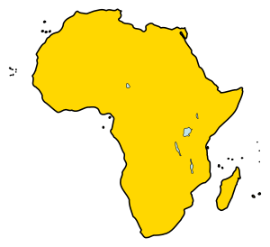
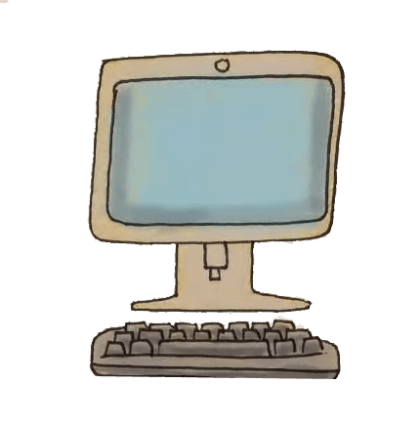
Designing our approach
Ilustrations © Nadia Mireles CC BY 3.0 sharingoer.com
Face to face course – 60 hrs of content
Funding& partnership
Facilitators:
Kenya
Ghana
Botswana
Open online course made up of OERs
Nurses, cataract surgeons, optometrists
Across all settings
CC - shared, adapted, re-used

Slide 11
Our approach
HOW
Created an 6 week open online course
Content: Planning and managing cataract and refractive error services
WHAT

Slide 12
Our approach
WHOM
Relevant for all cadres: teams and individuals (nurses, optometrists, clinical officers)
WHERE
Pilot tested in Kenya, Ghana and Botswana

Slide 13
Methods
Country facilitator
>60 steps of content: audiovisual, interactive, self paced
Downloadable features & use / reuse / adapt CC license
Follow up using Analytics, Pre and post course survey
Impact follow up after 6 months – qualitative study
Online course

Slide 14
Our experience
88 participants enrolled in the 3 countries (Kenya, Botswana and Ghana)
83% first online course
64% completers
32% partial completers
4% non starters
Post course survey
All except one respondent felt that participating in the course was a good learning experience (83% strongly agreed)

Slide 15
Follow up: Completer case study
“Very important source of information for myself and to share”
Isolated practitioner in remote setting
Intermittent internet and electricity – worked weekends and at night
Used 3G and smart phones
Application: understand local cataract backlog, plan services to increase CSR and address patient barriers

Slide 16
Partial completer
“I downloaded what I wanted and can go back to it as I need”
Remote setting
Limited internet and electricity
Workload
Personal motivation and time-management issues
Selected what was most relevant for their own setting

Slide 17
Country facilitator
“Huge numbers wanted to participate – but this was a pilot”
Open course – different cadres, different skills can participate
Creative commons license – enable free sharing
People in remote places can keep up
Relevance is in application at the practical level

Slide 18
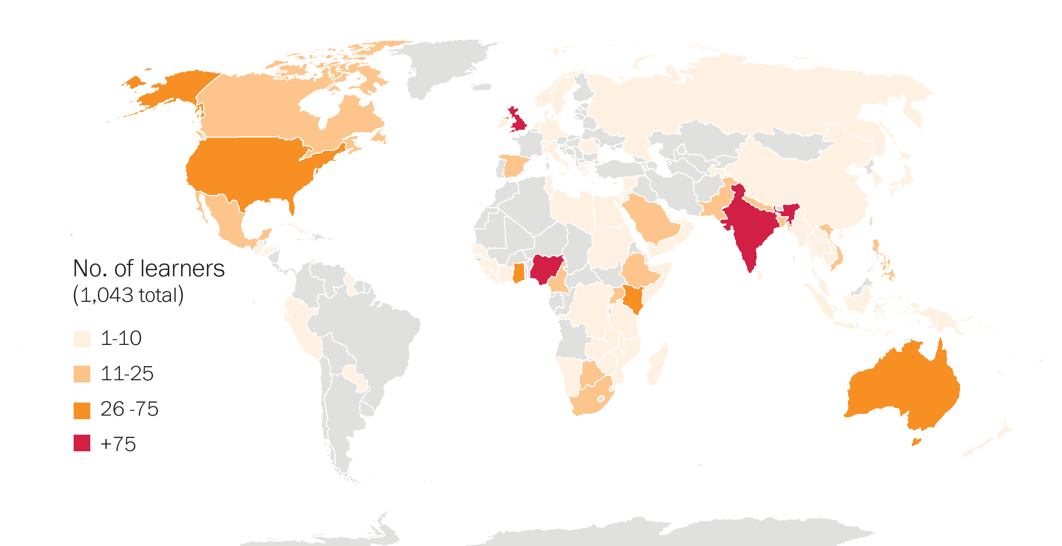
Learning and sustainability
EXPANSION SO FAR
5232 MOOC joiners
2849 active learners
**Localisation and embedding into local curriculum in progress
Expansion globally
68% from low- and middle- income countries ( 109 countries)
Distribution of learners by country. n= 1,043 (pre-course survey)
of 20

Slide 19
Developing a school screening programme
Materials
are
useful
Materials
could be adapted
Changed attitude towards empowering patients
Pilot: feedback
Now monitoring CSR
Image © Marc Wathieu CC BY-NC https://flic.kr/p/5xi8KT

Slide 20
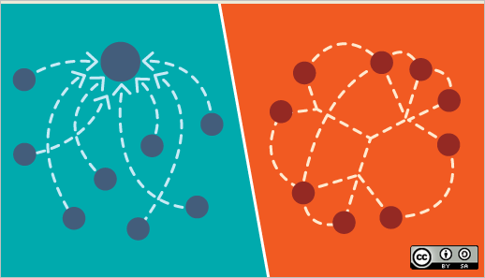
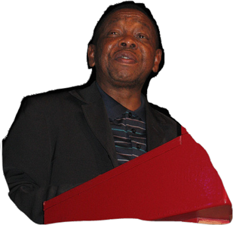
Conventional relationships in education
African universities are essentially consumers of knowledge produced in developed countries.
Minister of Higher Education, Blade Nzimande, UNESCO Conference on Higher Education, 2009
Notes:
Explain!

Slide 21
…can be replaced with networked relationships
Notes:
Explain!

Slide 22
Potential of Open Education
REUSE?
CURRICULUM RESOURCE
Who would do this?
Is it relevant for local accreditation?
Generic
Content
ADAPT
ACCESSIBILITY
Make it relevant for local setting
? Online or other technology .

Slide 23
Application of Open Education in eye care
CONTENT
Localise content
CC
Share
Adapt
Certify
Reuse
Ilustrations © Nadia Mireles CC BY 3.0 sharingoer.com

Slide 24
Managing quality
PRODUCT
Content selection
Content development
Assessment
Relevant content selection
Expert contribution and review
Partnerships with educators
Digital literacy to manage content
Adaptation with experts
Linking with regional and local eye care programmes and data
Align with relevance with ophthalmic curriculum guidelines
Relevance for Global action plan
Appropriate digital tools
POLICY
Content CC license
PLATFORMS
Curriculum changes
Availability
Accessible options
Sustainability
OPEN EDUCATION
Quality Assurance
Accreditations
(acceptance)
Capacity building
Educators
Analytics
Education institutions
PROMOTIONS
PARTNERSHIPS
Practitioners
Facilitations
Ministries
Marketing
Professional bodies

Slide 25
Conclusion
Growing demand for knowledge delivered outside the classroom
Open education is driven by Creative Commons license – use, reuse, adapt and share
Ownership of learning: self directed & self paced

Slide 26
Conclusion
Relevant selection of course content for wide user groups.
Completion is not an accurate marker of content impact
Quality resource is essential to maintain interest
Quality learning from experts and peers
Based on this experience we have expanded our courses to over 6000+ learners in 2 years
Futurelearn.com
Open Study at LSHTM - open.lshtm.ac.uk

Slide 27
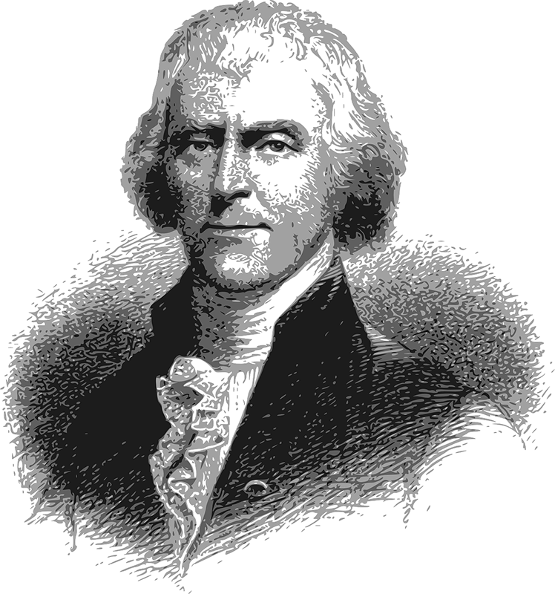
"He who receives an idea from me, receives instruction himself without lessening mine; as he who lights his taper [(candle)] at mine, receives light without darkening me."
Thomas Jefferson
OpenClipart-Vectors (CC O Public domain)
Thank you for listening

Slide 28
Dr Rob Farrow

Slide 29
Q&A
Ms Sally Parsley (Host) Technical lead, Open Education Programme, International Centre for Eye Health, LSHTM
Dr Daksha Patel E-learning Director, International Centre for Eye Health, LSHTM
Dr Rob Farrow Research Fellow, Learning and Teaching Innovation, Institute of Educational Technology, Open University

Slide 30
Thanks to our funders
Join us next time
Where to find and how to use Open courses?
March 15th 2017 (1-1.45pm UCT)
Register now at http://bit.ly/2lEvtuH
Find out more about the ICEH Open Education programme: http://iceh.lshtm.ac.uk/oer/

Slide 31
© 2017 International Centre for Eye Health, London School of Hygiene & Tropical Medicine. Unless otherwise stated, content is licensed under the Creative Commons Attribution Non-Commercial Share-Alike 4.0 International License https://creativecommons.org/licenses/by-nc-sa/4.0
We encourage the re-use, adaptation and sharing of this material for teaching and learning. Find more eye care Open Educational Resources at http://iceh.lshtm.ac.uk

