Slide 1
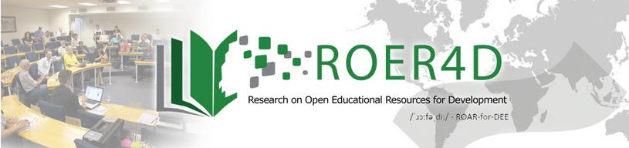

Research on Open Education Resources in the Global South
Glenda Cox, 24 May 2017
Presentation to International Centre for Eye Health

Slide 2
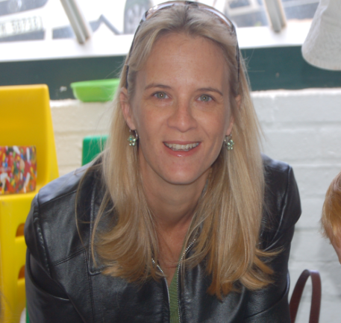

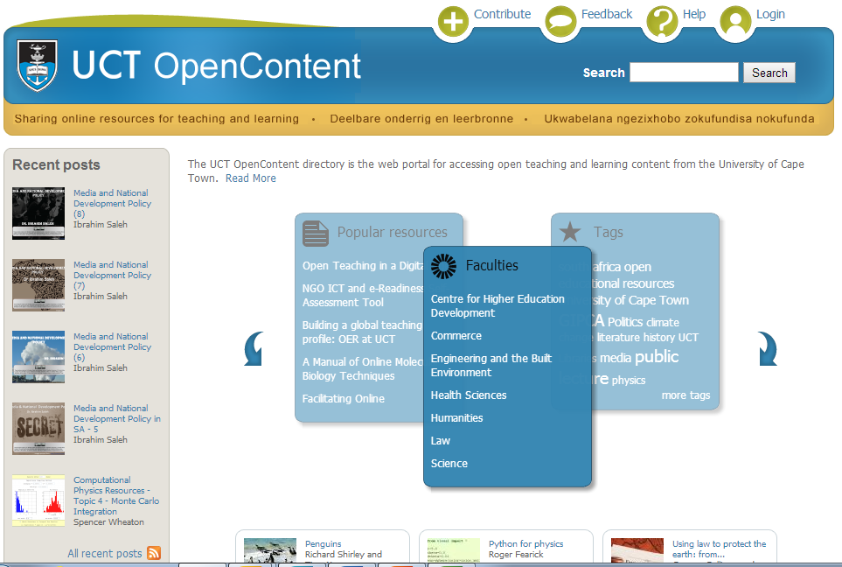
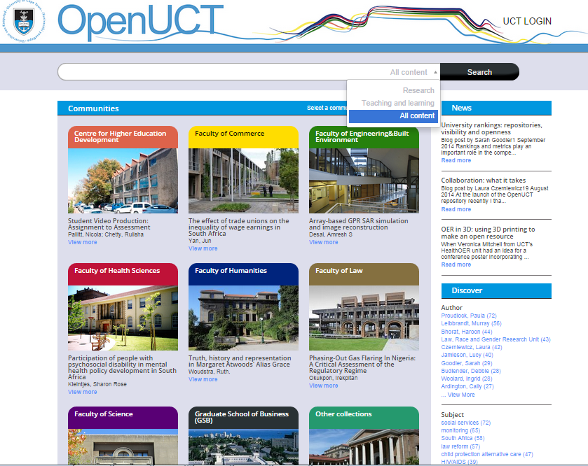
Glenda Cox, Senior Lecturer, University of Cape Town
Research
PhD
Management
Transition to Library-Training
Advocacy
Support

Slide 3
Some evidence from the Global South - ROER4D
The OER adoption pyramid-barriers to OER
What is an Open Education Practitioner?

Slide 4





Understanding lecturers’ adoption of OER: a multi-factorial approach
Glenda Cox & Henry Trotter
www.slideshare.net/ROER4D
Notes:
Welcome to this presentation on considering on understanding OER adoption at three SA universities. Henry and I both work in the Centre for Innovation and Teaching and Learning (CILT) at UCT. I will start with a short introduction and Henry will talk about the indicators of our approach.

Slide 5
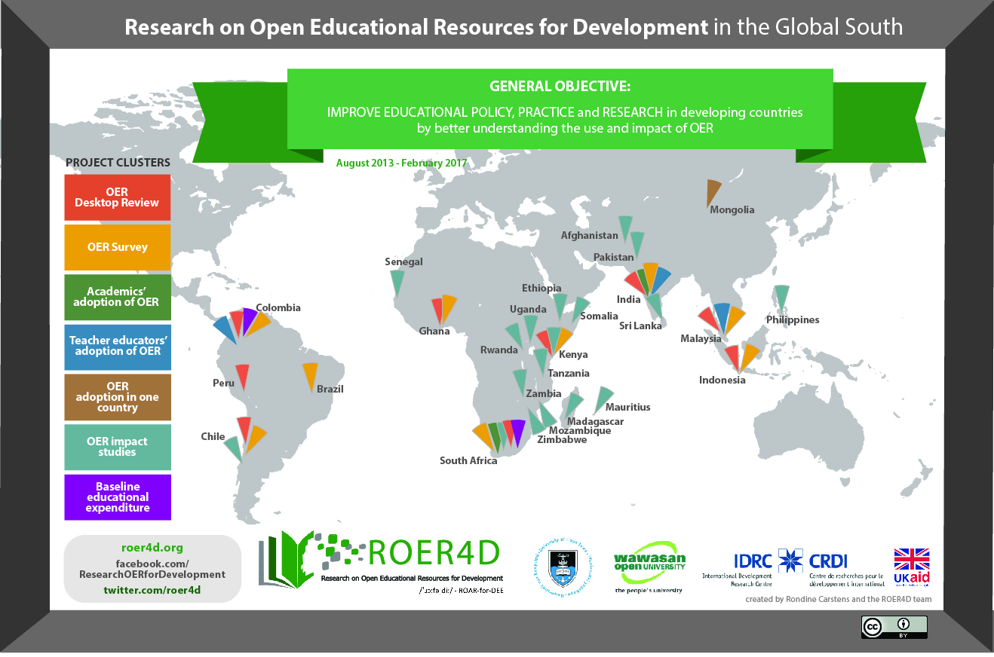
Notes:
The Research on Open Educational Resources for Development (ROER4D) project aims to provide evidence-based research from a number of countries in South America, Sub-Saharan Africa and South / South East Asia. The research here is from one of 18 sub-projects from 26 countries that aims to redress the current imbalance where so much research on OER is from the Global North. The primary objective of the programme is to improve educational policy, practice, and research in developing countries by better understanding the use and impact of OER. I conduct research in one of the programme’s sub-projects, focusing – with my colleague Henry Trotter - on OER in South Africa. For more information, see: http://www.roer4d.org

Slide 6



University Profiles | UCT | UFH | UNISA
Student access | Residential | Residential | Distance
Student numbers | 26 000 | 11 000 | 400 000+
Location | Urban | Rural | Dispersed
Approach | Traditional | Traditional | Comprehensive
Institutional culture | Collegial | Bureaucratic | Managerial
Copyright owner of teaching materials | Lecturers | Institution | Institution
Notes:
We travelled to the other universities and conducted workshops on OER and Creative Commons. These universities have quite different characteristics, as the table shows.

Slide 7
Interviews (N=18)
Introduction to OER and Creative commons workshops
6 interviewees per university
Structured, One-on-one
30 minutes–1 hour interviews
50-56 questions
Covering multiple elements of teaching and OER activity
Notes:
After conducting the workshops, we interviewed 6 staff members at each university on their teaching and OER in/activities.

Slide 8
Findings-Interviewees
 | Contribution | Non-contribution
Use | Contribution and use 2 | Non-contribution and use 9
Non-use | Contribution and non-use 0 | Non-contribution and non-use 7

Slide 9
The OER Adoption Pyramid
Personal
Individual values
Institutional
Financial, technical or policy support
Social
Departmental & disciplinary norms
Volition to adopt OER
Permission to use/create OER, according to institutional IP policy
Access to infrastructure: computers, internet connectivity, electricity
Capacity technical skills for using, creating, finding, uploading OER – personally or w/ support
Awareness of OER, the concept, and how it differs from other educational resources
Availability of relevant OER of requisite quality (for use or sharing)
INDIVIDUALS may be
agents of OER adoption
INSTITUTIONS may be agents of OER adoption
INTERNALLY DETERMINED
EXTERNALLY DETERMINED
Notes:
As we were conducting our research, it became clear that a number of factors shaped OER adoption decisions at these universities. But 6 of them stood out as having a “determinative” effect on OER activity and its potential. These are factors which, if you ask, “can OER activity proceed here without them?”, the answer would be “no”. So we developed what we call The OER Adoption Pyramid.

Slide 10
If the factors are in place then…

Slide 11
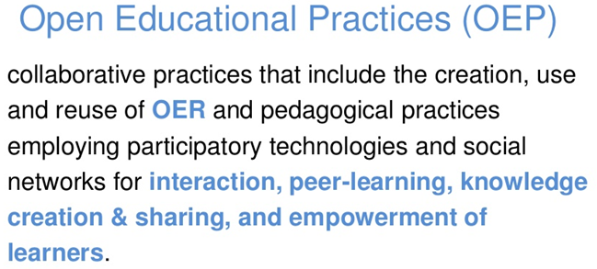
What is an Open Education Practitioner?
By Catherine Cronin. University of Galway, Ireland
https://aran.library.nuigalway.ie/handle/10379/6394
Open educational practice covers any significant change in educational practice afforded by the open nature of the internet.
By Martin Weller. Open University, England

Slide 12
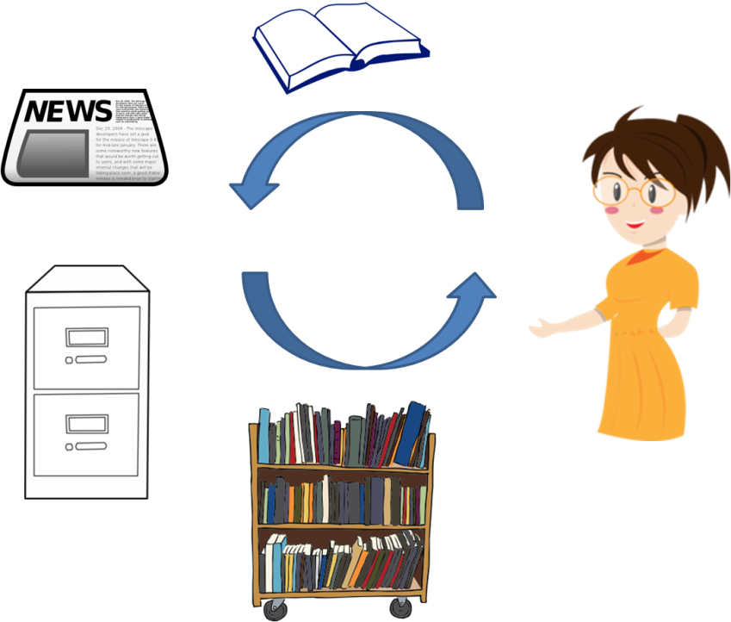
Pedagogy
Enabler
Constraint
Creation: interactive teaching styles do not always result in online materials
Use: difficult to find relevant OER

Slide 13
Your online presence
Research project: Instruments and research data on Datafirst (https://www.datafirst.uct.ac.za/dataportal/index.php/catalog/central)
Articles in Open Access Journals
Open education resources: Slides in Slideshare: eg. Introduction to OER (+4000 views)
Slides and other materials in OpenUCT
Thesis in OpenUCT when examined later in the year
Twitter for communicating all of the above
Notes:
4452 views in one Slideshare on Openness

Slide 14
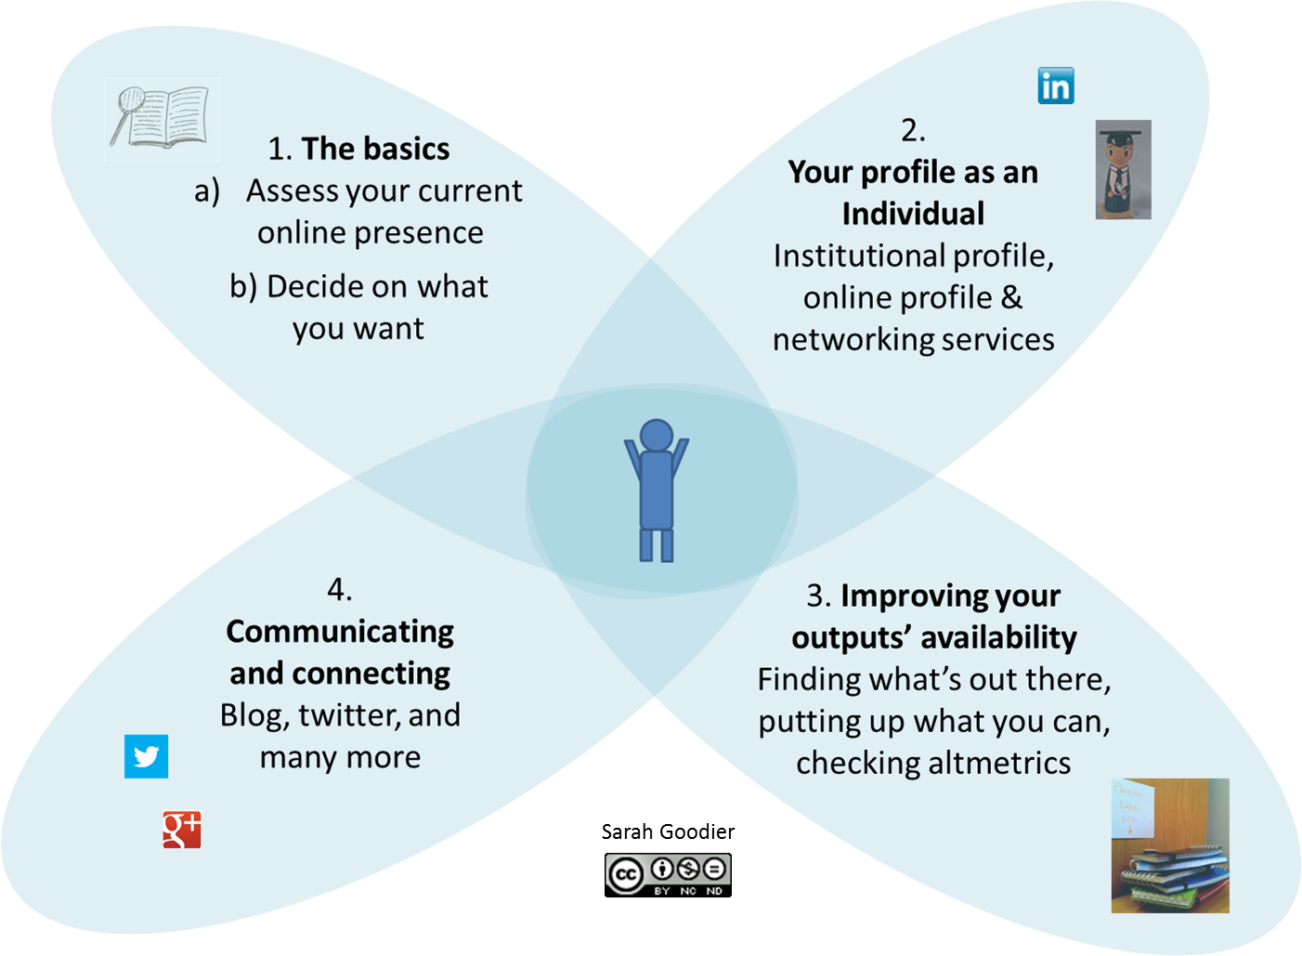
The process
Notes:
Magnifying glass image (top left) by Tall Chris available at http://www.flickr.com/photos/tallchris/14288135/ under CC BY 2.0 (http://creativecommons.org/licenses/by/2.0/deed.en)
Academic image (2nd from the top right) by Tim Ellis available at: http://www.flickr.com/photos/tim_ellis/2269499855/ under CC BY-NC 2.0 (http://creativecommons.org/licenses/by-nc/2.0/deed.en)

Slide 15
Further reading
http://roer4d.org/
http://www.oeconsortium.org/
https://www.yearofopen.org/
http://www.oerafrica.org/

